Slide 1
Gazprom on Hybrid Markets of Europe
Sergei Komlev
Head of Contract Structuring and Price Formation Directorate,
Gazprom Export
“Energy: Perspectives and Challenges”
Regional Conference
Novi Sad, March 11, 2016

Slide 2
Deliveries by Major Countries in 2015
Deliveries by Major Exporters
Bcm
 | 2014 | 2015 | Changes | Changes, %
Gazprom JSC | 146.6 | 158.6 | 12.0 | 8.2%
Algeria (incl. LNG) | 38.9 | 36.1 | -2.8 | -7.2%
Qatar | 23.7 | 28.1 | 4.4 | 19.0%
Iran | 9.2 | 8.7 | -0.5 | -6.0%
Lybia (incl. LNG) | 4.8 | 5.7 | 0.9 | 19.2%
Deliveries by Major Indigenous Producers
Bcm
 | 2014 | 2015 | Changes | Changes, %
Norway* | 115.6 | 125.5 | 9.9 | 8.6%
Netherlands | 63.1 | 48.6 | -14.2 | -23.1%
United Kingdom | 41.2 | 43.9 | 2,7 | 6.7%
* Including pipeline and LNG supply of Norway to the European market, but not supply to Asia and America
Source: Bloomberg, IEA, Eurostat, National Statistical Agencies, Estimates by Gazprom Export LLC as of January 2016

Slide 3
LNG Deliveries to Europe by Country
Bcm
 | 2014 | 2015 | Changes | Changes, %
Qatar | 23.7 | 28.1 | 4.5 | 19.0%
Algeria | 14.5 | 12.4 | -2.1 | -14.3%
Nigeria | 6.0 | 8.0 | 2.0 | 33.2%
Norway | 2.6 | 2.9 | 0.3 | 10.8%
Trinidad and Tobago | 3.6 | 1.8 | -1.8 | -49.6%
Peru | 1.3 | 1.5 | 0.1 | -10.6%
Yemen | 0.0 | 0.1 | 0.1 | -
Oman | 0.0 | 0.1 | 0.1 | 12.1%
Equatorial Guinea | 0.1 | 0.0 | -0.1 | -
Total | 51.8 | 54.9 | 3.1 | 5.9%
Source: Bloomberg, Estimates by Gazprom Export LLC

Slide 4
Long Term European Natural Gas Consumption
According to consensus forecast for 2025 and 2035, European gas demand could be 15% and 21% higher compared to 2015
Source: Gazprom Export

Slide 5
Natural Gas European Demand and Production Gap
Due to the falling indigenous production European demand for additional gas imports may be 110 bcm by 2025 and 160 bcm by 2035
Source: Gazprom Export

Slide 6
Supply from Russia Covers Import Requirements of Serbia
Source: IHS

Slide 7
Power Generation and Industry are the Major Consumers of Natural Gas in Serbia
Source: IHS

Slide 8
IHS Projects Growth in Demand for Natural Gas
Source: IEA
+60%
Source: IHS

Slide 9
Gas-on-Substitute Competition versus Gas-On-Gas Competition in the European ‘Far Abroad’, 2015 (1)
2014
2015
60,6%
58,6%
39,4%
41,4%
Source: IEA, «Gazprom export» LLC assessment

Slide 10
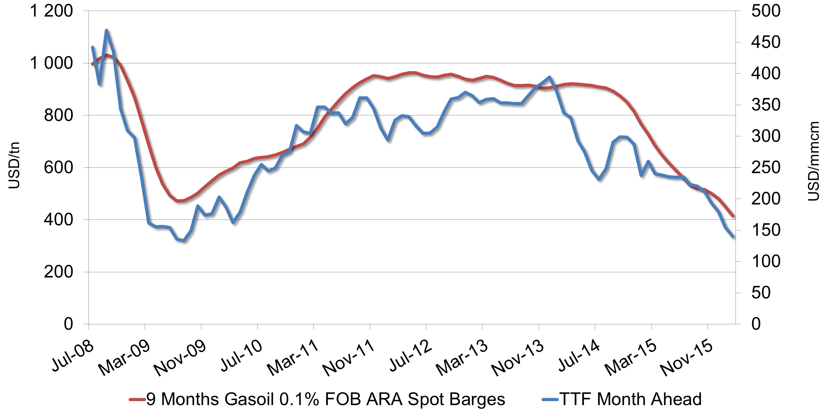
Tight Correlation between European Gas-oil and TTF Prices
Evolution of 9 months moving average gasoil and TTF Month Ahead prices, 2008-2016
Correlation coefficient = 0.87
R Square = 0.76
Engle-Granger test for cointegration succeeded
Source: Bloomberg

Slide 11
Price Corridor for Natural Gas is Set by
Inter-Fuel Competition
Ceiling
Oil/Oil products parity
Floor
Coal parity

Slide 12
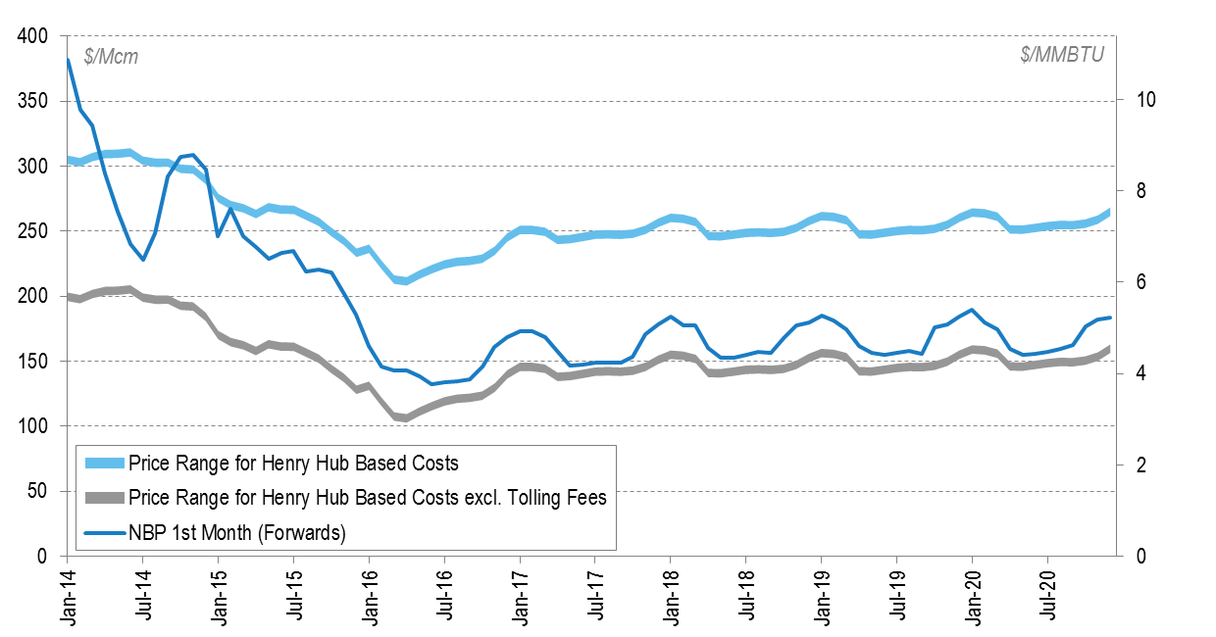
Full Costs of LNG Deliveries from North America to Europe
Price Range* of US LNG Deliveries to Europe
vs. Forward Prices** of European Hubs
In the medium-term, full costs of LNG deliveries to Europe are significantly higher than the forward prices.
* P = HH * 115% + X, where HH – Henry Hub Forwards, X – total volume of estimated costs, pls., see slide #3
** NBP Forwards
Source: Bloomberg, Wood Mackenzie

Slide 13
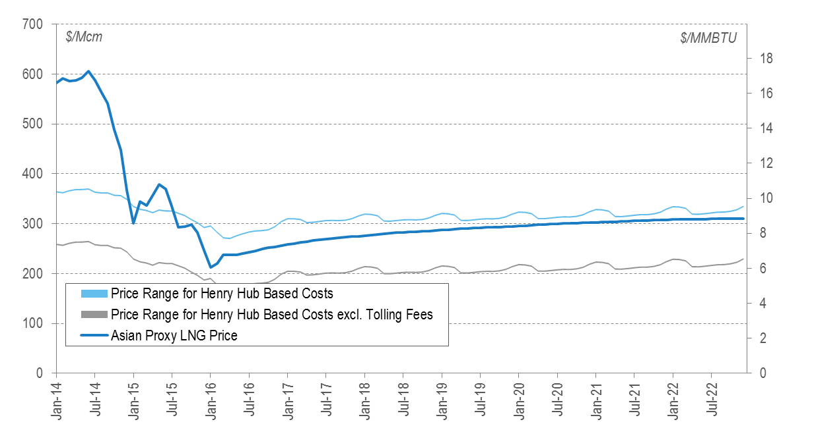
Full Costs of LNG Deliveries from North America to Asia
Price Range* of US LNG Deliveries to Asia
vs. Estimated Prices** of Asian Proxy Contract
Full costs of deliveries of American LNG to Asia are higher than prices under proxy for a standard Asian contract in the medium-term, nevertheless oil price recovery may minimize loses.
* Based on oil forward prices and contract formula P ($/MMBTU) = 14% х Brent Futures + 1.6
Source: Argus, Bloomberg, Wood Mackenzie

Slide 14
US LNG Exports to Europe and Asia
US FOB LNG Price (2018-2020) =
$6.0 – $6.5/MMBTU
(115%*HH + $3.0/MMBTU)
Transport
Regas.
Breakeven
NBP
Margin
Europe
(UK)
$0.69
$0.40
$7.59
vs.
$4.3– $5.4
≈
- $2.7
14%JCC+1.6
Asia
(Japan, Korea)
$2.38
$0.40
$9.28
vs.
$8.0–$8.5
≈
- $1.0
As of Q1 2016, Asian premium is USD 1.7 MMBTU.
Source: Bloomberg, Wood Mackenzie

Slide 15
THANK YOU FOR YOUR ATTENTION!

